Slide 1
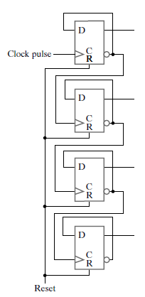
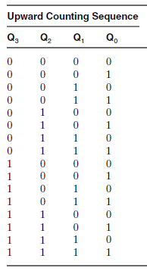
4-bit Ripple Counter
What will be the state of counter on positive edge after 1111?

Slide 2
4-bit Ripple Counter
1st +ve edge
2nd +ve edge
3rd +ve edge
1
0
1
0
1
0
1
0
1
0
1
0
0
1
1
0
1
0
0
0
0
0
0
0
0
0
0
0
0
0
What will be the state of counter on positive edge after 1111?

Slide 3
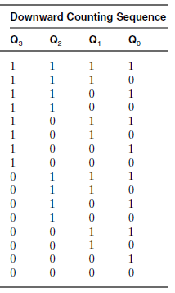
4-bit Ripple Counter
Design a 4-bit ripple counter for downward counting
Can you design an asynchronous Up-Down
Counter with Selection Input?

Slide 4
Clock +ve edge & -ve Edge difference in Moris Mano

Slide 5
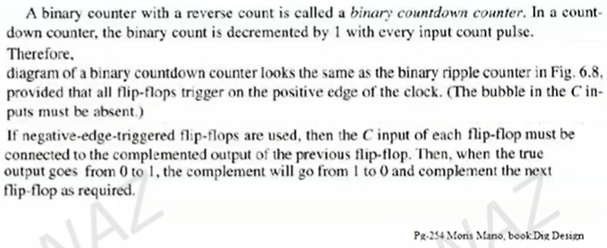
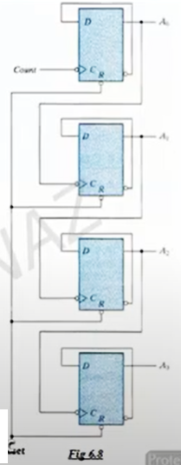
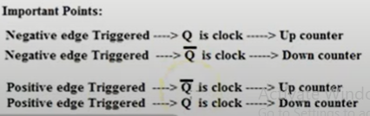

Slide 6
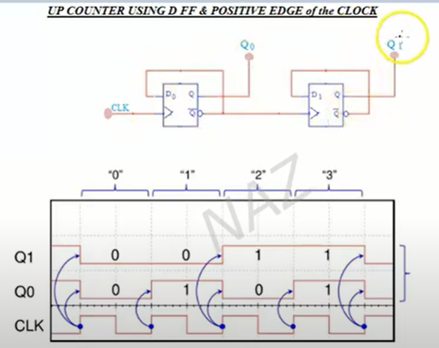
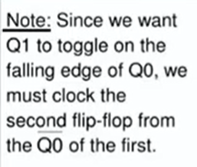

Slide 7
Synchronous Counters

Slide 8
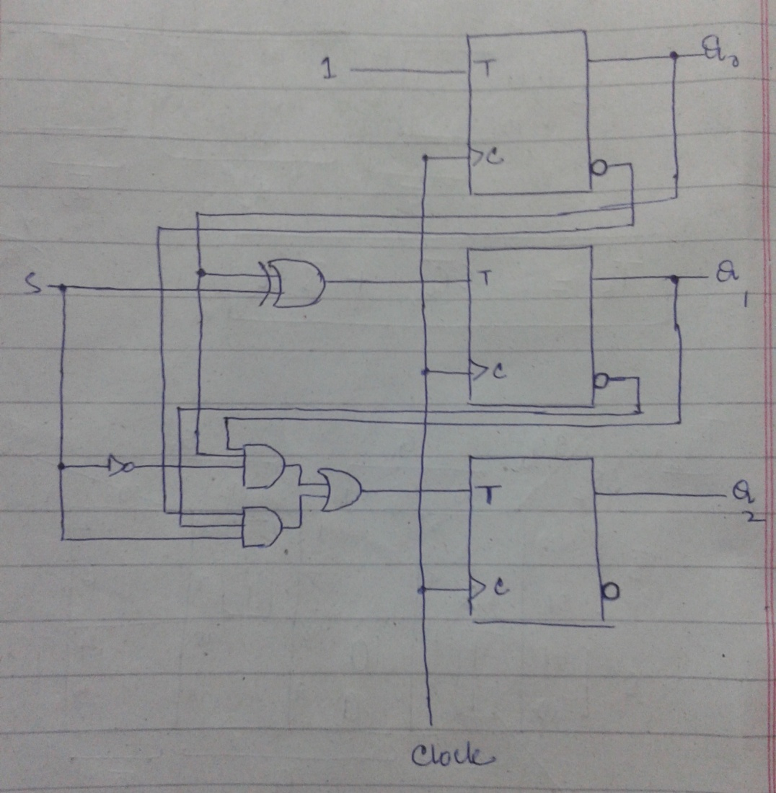
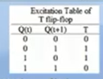
Synchronous 3-bit Up-Down Counter
For S=0 ➔ Count Upward
For S=1 ➔ Count Downward
QA
FF A
QB
S
FF B
QC
FF C

Slide 9
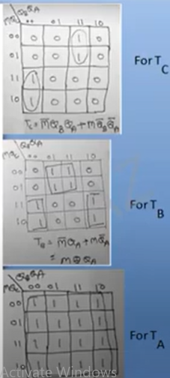

Slide 10
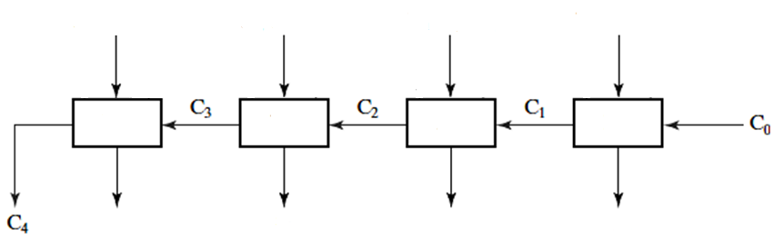
Serial Counter
Q3(t)
Q2(t)
Q1(t)
Q0(t)
EN
HA
HA
HA
HA
Q3(t+1)
Q2(t+1)
Q1(t+1)
Q0(t+1)

Slide 11
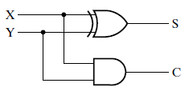
Half Adder

Slide 12
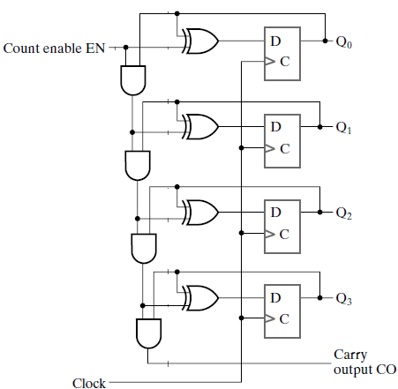
Serial Counter
Notes:
4-Bit Synchronous Binary Counter with Serial Gating. Page 360 – Moris Mano 4th Edition

Slide 13
Serial Counter
Half Adders

Slide 14
Serial Counter
S0
C1
S1
C2
S2
C3
S3
C4

Slide 15
Serial Counter
If EN = 0, Hold Data
If EN = 1, Increment by 1

Slide 16
How Serial Counter Works?
1
0
1
0
0
Value at time t = 0010
What will be the value at time t+1

Slide 17
How Serial Counter Works?
0
1
1
0
0
Qi outputs coming to
XORs and ANDs

Slide 18
How Serial Counter Works?
0
1
1
1
0
0
0

Slide 19
How Serial Counter Works?
0
1
1
1
0
1
0
0
0

Slide 20
How Serial Counter Works?
0
1
1
1
0
1
0
0
0
0
0

Slide 21
How Serial Counter Works?
0
1
1
1
0
1
0
0
0
0
0
0
0

Slide 22
How Serial Counter Works?
0
1
1
1
0
1
0
0
0
Value of this AND depends
On three ANDs in previous
Levels of gating
0
0
0
0

Slide 23
How Serial Counter Works?
0
1
1
1
0
1
0
0
0
0
0
0
This data will be
available at next tick
0

Slide 24
How Serial Counter Works?
1
1
1
0
0

Slide 25
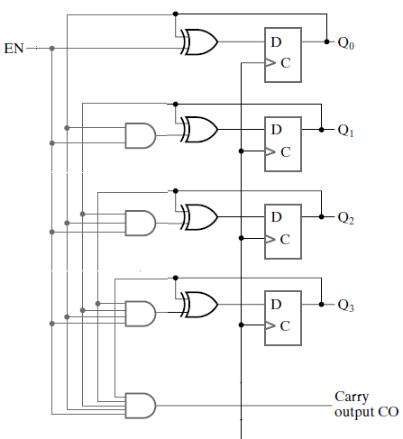
Parallel Counter
Clock
Notes:
4-Bit Synchronous Binary Counter with Parallel Gating. Reference: Page 360 Moris Mano 4th Edition

Slide 26
How Parallel Counter works?
1
0
1
0
0
Value at time t = 0010
What will be the value at time t+1
Clock
Notes:
4-Bit Synchronous Binary Counter with Parallel Gating. Reference: Page 360 Moris Mano 4th Edition

Slide 27
How Parallel Counter works?
1
0
1
0
0
Clock
Notes:
4-Bit Synchronous Binary Counter with Parallel Gating. Reference: Page 360 Moris Mano 4th Edition

Slide 28
How Parallel Counter works?
1
0
1
1
0
0
This signal 0 is coming from Q0
0
0
0
0
Clock
Notes:
4-Bit Synchronous Binary Counter with Parallel Gating. Reference: Page 360 Moris Mano 4th Edition

Slide 29
How Parallel Counter works?
1
0
1
1
0
0
All the ANDs which got 0
Gave output 0
0
0
0
0
Clock
Notes:
4-Bit Synchronous Binary Counter with Parallel Gating. Reference: Page 360 Moris Mano 4th Edition

Slide 30
How Parallel Counter works?
1
1
1
0
X XOR 1 = X’
X XOR 0 = X
0
0
Clock
Notes:
4-Bit Synchronous Binary Counter with Parallel Gating. Reference: Page 360 Moris Mano 4th Edition

Slide 31
How Parallel Counter works?
1
1
1
0
This data will be available
On counter output at time t+1
0
0
Clock
Notes:
4-Bit Synchronous Binary Counter with Parallel Gating. Reference: Page 360 Moris Mano 4th Edition

Slide 32
How Parallel Counter works?
1
1
1
0
Counter at time t+1
0
0
Clock
Notes:
4-Bit Synchronous Binary Counter with Parallel Gating. Reference: Page 360 Moris Mano 4th Edition

Slide 33
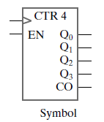
4-Bit Synchronous Binary Counter

Slide 34
Serial VS Parallel Counter
Clock
Gate delay being accumulated in Serial Counter as last AND is at level 4 of gating.
For example, going from state 1111 to state 0000.

Slide 35
Serial VS Parallel Counter
Clock
Output of 4th AND gate depends on the outputs of all previous AND gates.
i.e. Delay of four AND Gates being accumulated.

Slide 36
Practice Problems
1. Arbitrary Count Sequence: Design a synchronous counter which follows sequence given below:
0, 2, 4, 6, 8, 0, 2,…
2. BCD Counter: Design a BCD synchronous counter which follows the sequence given below:
0,1,2,3,4,5,6,7,8,9,0,1,2,…

Slide 37
Practice Problems
3. Modulo-7 Counter: Which follows the sequence 0,1,2,3,4,5,6,0,1,2,…
4. Digital Watch
For your convenience consider we have 64 seconds in one minute, 64 minutes in one hour and total 32 hours in a day.

Slide 38
Practice Problems
5. Automatic Parking Control
Take CarIn and CarOut signals from sensors at Entry and Exit Gates respectively. Parking area has total capacity of 32 cars, when total count of cars in the plaza reaches 32 lock the Entry Door otherwise the door will remain unlocked.
6. Counter with Parallel Load
Register composed of D Flip-Flops which loads the data if Load = 1 otherwise behaves like a binary counter.

Slide 39
Practice Problems
7. Counter composed of D Flip-Flops which takes X and Y selection inputs and performs following operations:
X | Y | Operation
0 | 0 | Count
0 | 1 | Shift Right
1 | 0 | Shift Left
1 | 1 | Parallel Load

